Slide 1

City Intersection Clustering Based on Time Series Data
Mohammad Aminazadeh
Fakhroddin Noorbehbahani
1/16

Slide 2
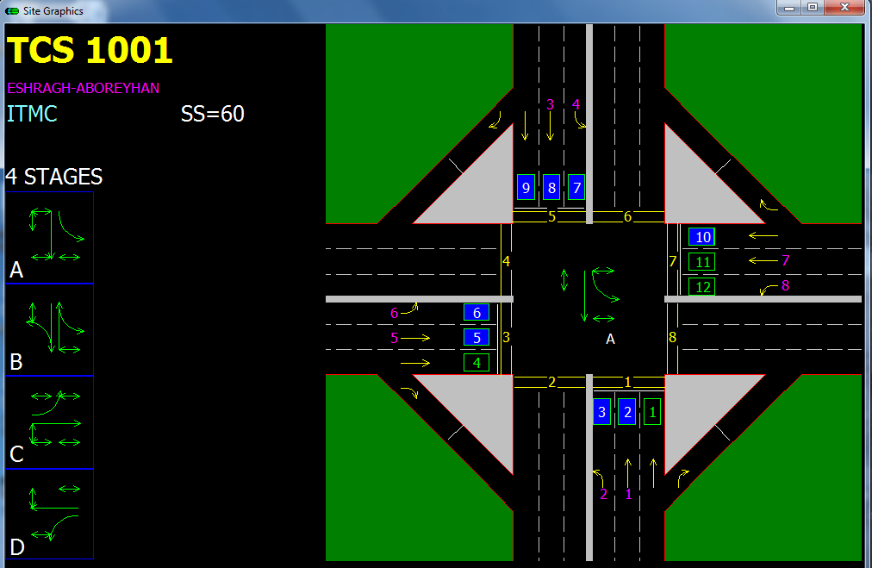
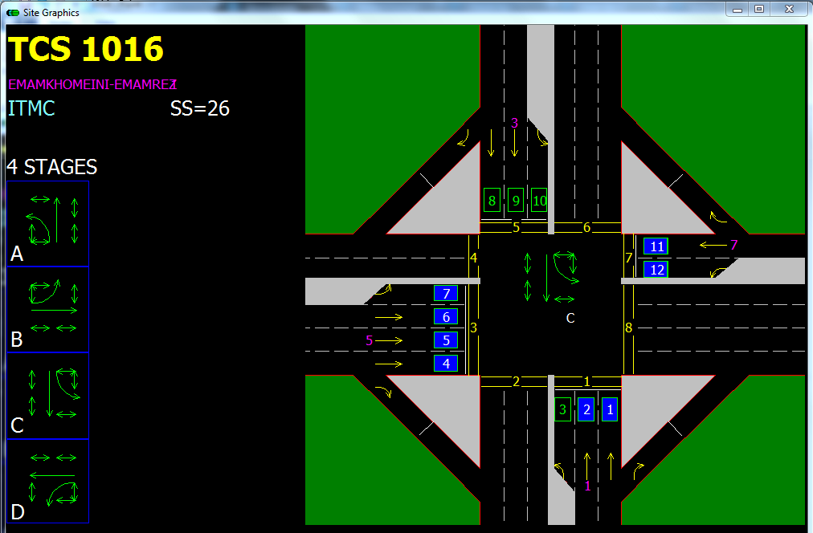
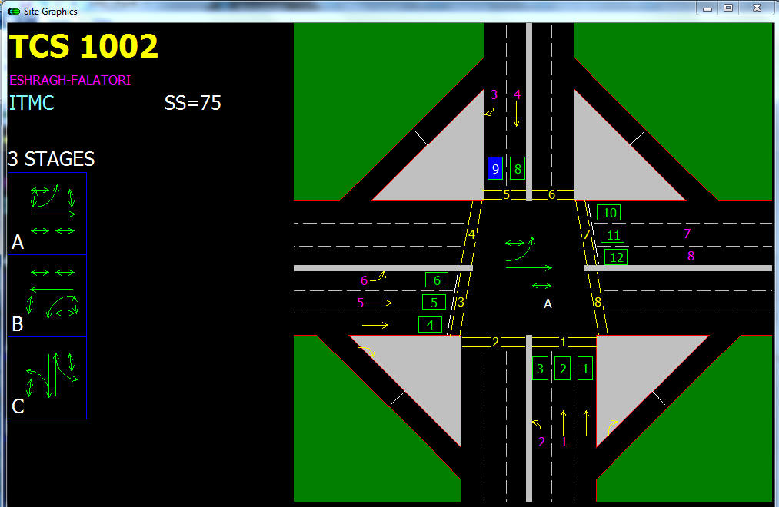
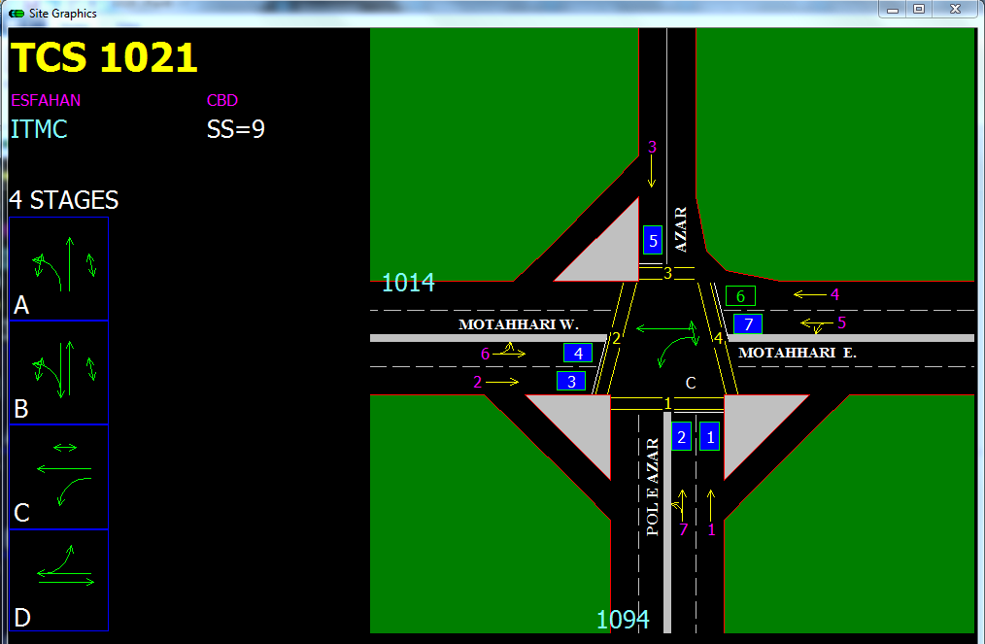
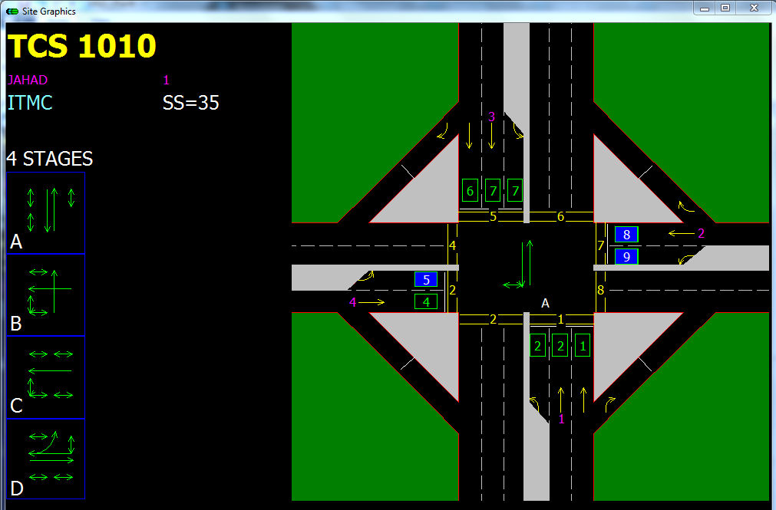
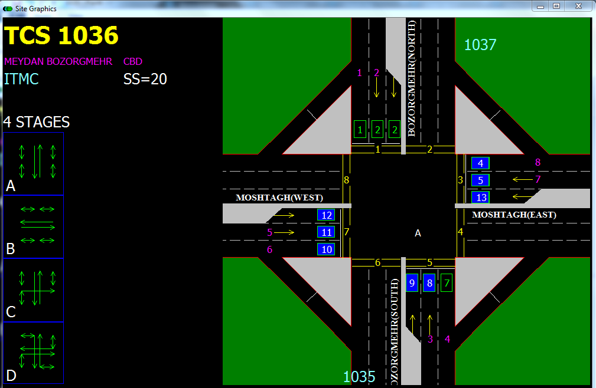
Introduction data source
71 INTERSECTIONS
2/16

Slide 3
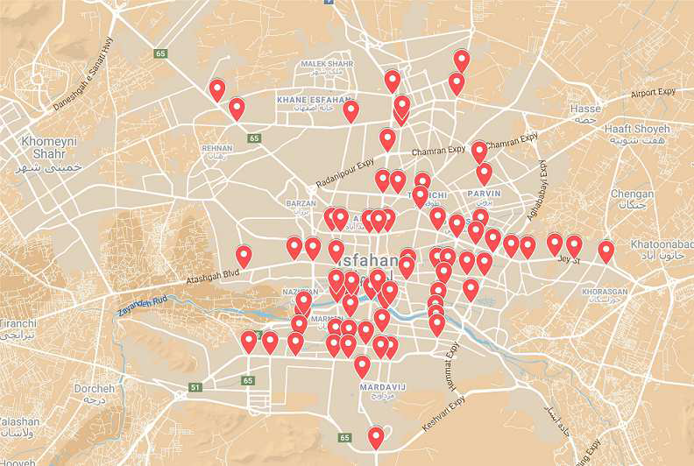
Introduction Intersections distribution
3/16

Slide 4
Introduction data Volume
37 Months of Data in Text Files From October 2018 to November 2021
Each File Containing 350K Lines
Total of About 13 Million Lines of Traffic Records
Big Data
4/16

Slide 5
What do we aim to find out?
Time Series Visualization
Research Questions
Intersection Clustering
How Does Traffic Flow Change in 24 hours of the day concerning each season of the year?
What are The traffic flow trends in 24 hours of the day concerning each day of week?
At which hours of the day do peaks and valleys happen in traffic flow?
Which intersections have similar behaviors?
5/16

Slide 6
Analysis Process
PHASE 5
Time Series Clustering
PHASE 4
Time Series Visualization
PHASE 3
Traffic Values and Time Aggregation
PHASE 2
Handling Missing Values
PHASE 1
Data Cleaning and Intersection Separation
6/16

Slide 7
Comparison to Related Works
Traffic Time Series Clustering and Pattern Extraction
Traffic Data Visualization and Pattern Recognition
Traffic Flow Prediction
7/16

Slide 8
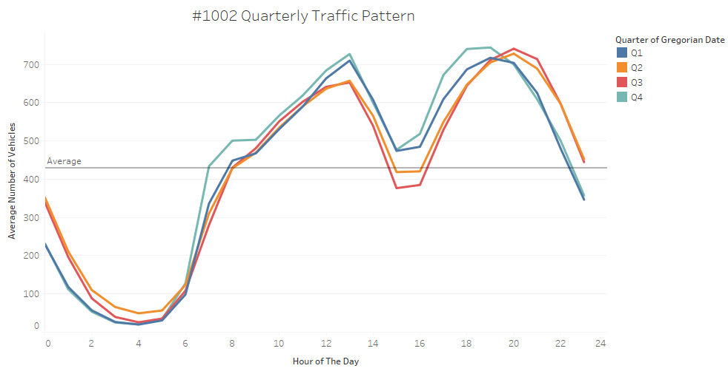
Quarterly Visualization Results
8/16

Slide 9
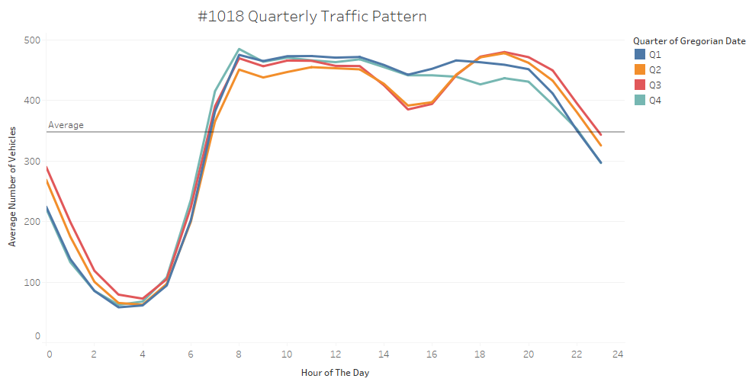
Quarterly Visualization Results
9/16

Slide 10
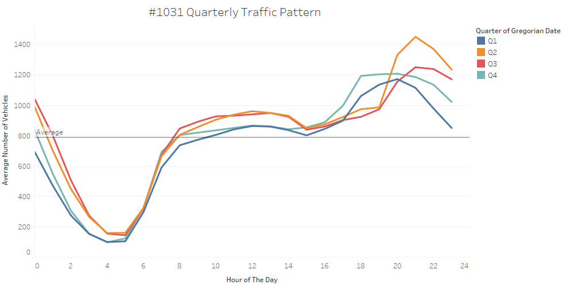
Quarterly Visualization Results
10/16

Slide 11
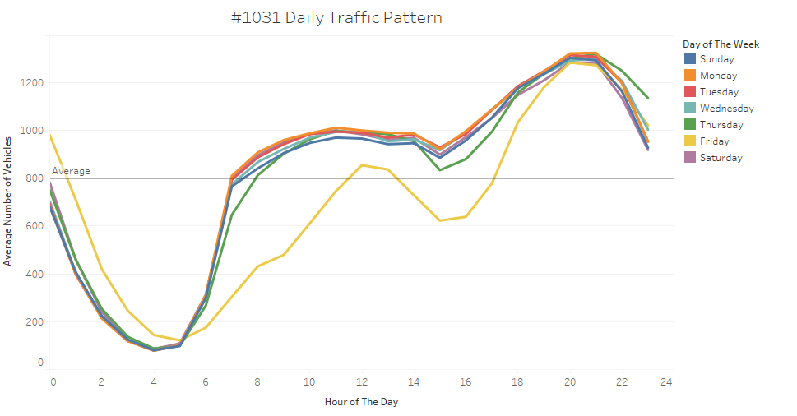
Week Days Visualization Result
11/16

Slide 12




Clustering Process
Algorithm
The Optimum k
Clusters Visualization
Analysis
Finding the best algorithm for our problem
Choosing the optimum number of clusters
Visualizing each cluster to obtain patterns
How intersections are separated and why?
12/16

Slide 13
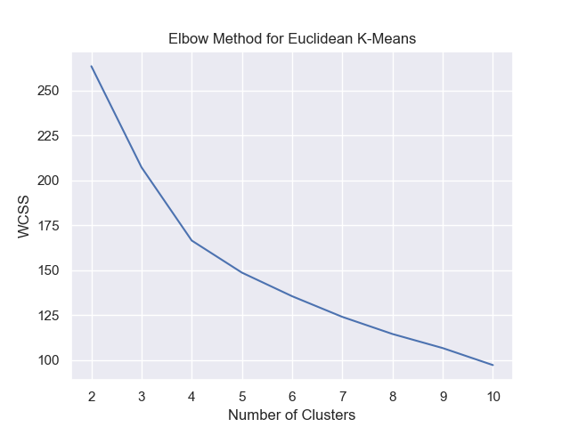
The Optimum k
Optimum number of clusters is choosed via “The Elbow Method” that tries to minimize WCSS. This Algorithm resulted in k=5
13/16

Slide 14
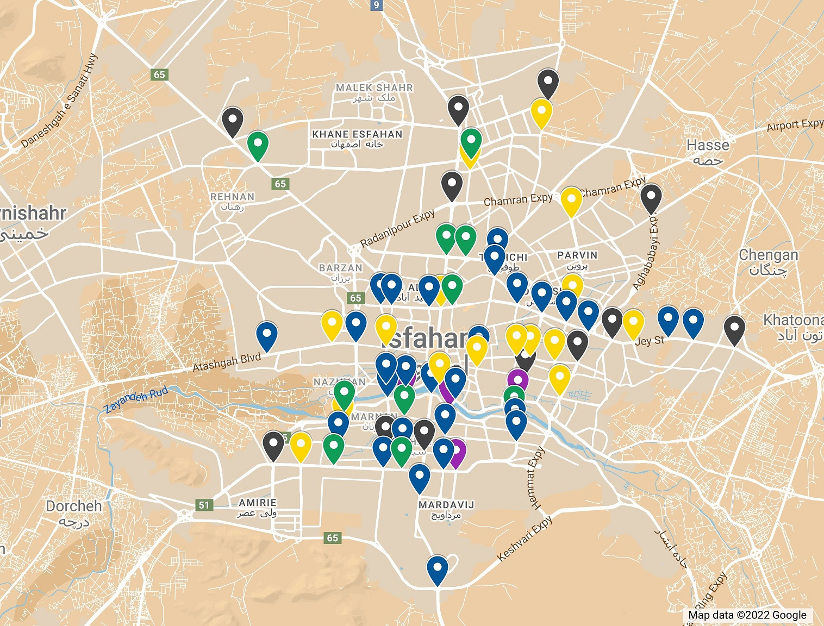
Clusters Visualization
Cluster | Color on Map | Functionality
1 | Green | North-South Connection/Transportation
2 | Black | Out-of-City Transportation
3 | Blue | Main Business/Entertainment Centers
4 | Yellow | Out-of-City Transportation
5 | Purple | Riverside Transportation
14/16

Slide 15
References
W. Chen, F. Guo, and F. Y. Wang, “A Survey of Traffic Data Visualization,” IEEE Trans. Intell. Transp. Syst., vol. 16, no. 6, pp. 2970–2984, 2015, doi: 10.1109/TITS.2015.2436897.
N. Hayashi and Y. Shiraishi, “A method for summarizing and visualizing city traffic data,” 2014 7th Int. Conf. Mob. Comput. Ubiquitous Networking, ICMU 2014, pp. 165–170, 2014, doi: 10.1109/ICMU.2014.6799089.
T. Tsuboi, “Traffic congestion visualization by traffic parameters in India,” Int. Conf. Innov. Comput. Commun., pp. 371–380, 2020.
Z. Zamani, M. Pourmand, and M. H. Saraee, Application of Data Mining in Traffic Management: Case of City of Isfahan.
H. Zhang, Y. Zhang, Z. Li, and D. Hu, “Spatial – Temporal Traffic Data Analysis Based on Global Data Management Using MAS,” Ieee Trans. Intell. Transp. Syst., vol. 5, no. 4, pp. 267–275, 2004.
C. Tominski, H. Schumann, G. Andrienko, and N. Andrienko, “Stacking-based visualization of trajectory attribute data,” IEEE Trans. Vis. Comput. Graph., vol. 18, no. 12, pp. 2565–2574, 2012, doi: 10.1109/TVCG.2012.265.
M. Picozzi, N. Verdezoto, M. Pouke, J. Vatjus-Anttila, and A. Quigley, “Traffic visualization: Applying information visualization techniques to enhance traffic planning,” GRAPP 2013 IVAPP 2013 - Proc. Int. Conf. Comput. Graph. Theory Appl. Int. Conf. Inf. Vis. Theory Appl., pp. 554–557, 2013, doi: 10.5220/0004291605540557.
J. Pu, S. Liu, Y. Ding, H. Qu, and L. Ni, “T-watcher: A new visual analytic system for effective traffic surveillance,” Proc. - IEEE Int. Conf. Mob. Data Manag., vol. 1, pp. 127–136, 2013, doi: 10.1109/MDM.2013.23.
L. Po, F. Rollo, C. Bachechi, and A. Corni, “From sensors data to urban traffic flow analysis,” 5th IEEE Int. Smart Cities Conf. ISC2 2019, pp. 478–485, 2019, doi: 10.1109/ISC246665.2019.9071639.
15/16

Slide 16


Thank You
16/16

